Slide 1
2023

Slide 2
New Faculty Presentation

Slide 3
Retirement system options
Teachers’ and State Employees’ Retirement System (TSERS)
Optional Retirement Program
(ORP)
MANDATORY ENROLLMENT in TSERS or ORP

Slide 4
TSERS Plan highlights
Traditional defined benefit plan
Steady monthly income for life
Monthly benefit determined by a formula
Stable and secure retirement income
Professional asset management by the NC Treasurer’s Office
Accumulate retirement income without individual risk
Vesting period-5 Years

Slide 5
ORP Highlights
Defined contribution plan
Greater control over investments
Greater choice of distribution options
Portability outside of North Carolina
2 Vendors to choose from: TIAA or FIDELITY
100% Vested in Employee Contributions Day 1
100% Vested in Employer Contributions-5 Years

Slide 6
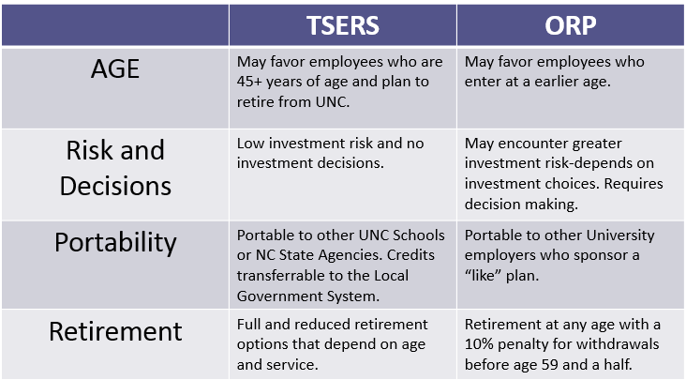

Slide 7
State Health Plan & Other Benefit Plans
Health Insurance: 80/20 & 70/30 PPO plans
Employer premium: $674.54/month
Supplemental Benefits: Life Insurance, Vision, Dental, Accident, AD&D, Cancer, Critical Illness, Flexible Spending Accounts, Tricare Supplemental Plan
Supplemental Disability: The Standard and Lincoln

Slide 8
Enrollment must be completed online
Log in to myWCU
Select Human Resources/Human Resources Home
Click on the Access Benefits tab
Telephone enrollment: 855.859.0966
Your employment information is automatically uploaded in the enrollment system
The upload occurs each Monday

Slide 9
Dependent verification documentation is required for all dependents. You can upload these documents in eBenefits, the Plan’s enrollment system
Dependent coverage will not be approved without
documented proof of dependents

Slide 10
Annual Enrollment
Annual Enrollment for the new calendar year plan year is scheduled for October 9, 2023, thru October 27, 2023
New plan year will be from…
January 1, 2024, to December 31, 2024
Plan design changes and premiums for 2024 are still pending…

Slide 11
Questions?
Welcome to Western Carolina University!

