Slide 2
Disquisition Process
From Proposal to Defense and everything in the middle
Notes:
The Graduate School wants you to be successful in this endeavor. IT means keeping up and staying in contact. nThis presentation is for students who are “on time” with their cohorts—any variations should be worked out with Jess Weiler and Committee chair.

Slide 3
The DQ proposal
Spring 1-Spring 2
Spring 1 semester—students and Ed.D. faculty will create a DQ topic, approve DQ topic and identify appropriate DQ committee chairs (internal program process)
Fall 2 semester—students and chair identify committee membership
*It is the responsibility of committee chair to ensure all committee members have graduate faculty status
Late Fall 2 and/or early Spring 2 students will defend DQ Proposal to their committee
Following a successful defense of the DQ Proposal, students should create an account in Proquest—and upload several documents (see following slide)

Slide 4
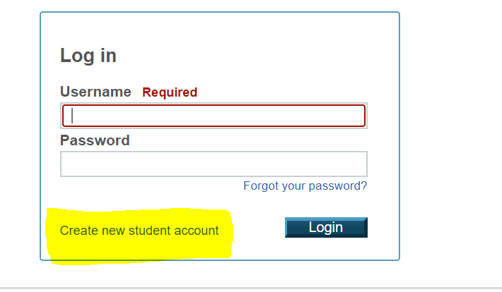
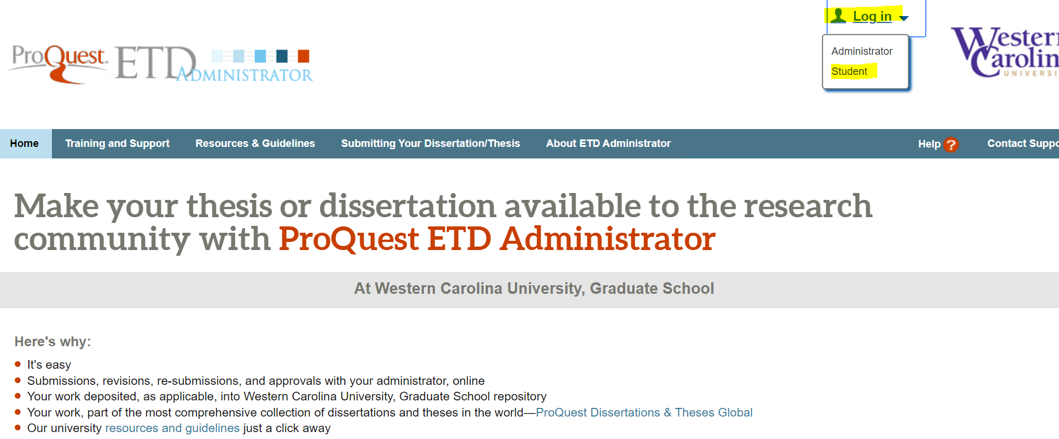
Create a proquest account
https://www.etdadmin.com/main/home?siteId=149

Slide 5
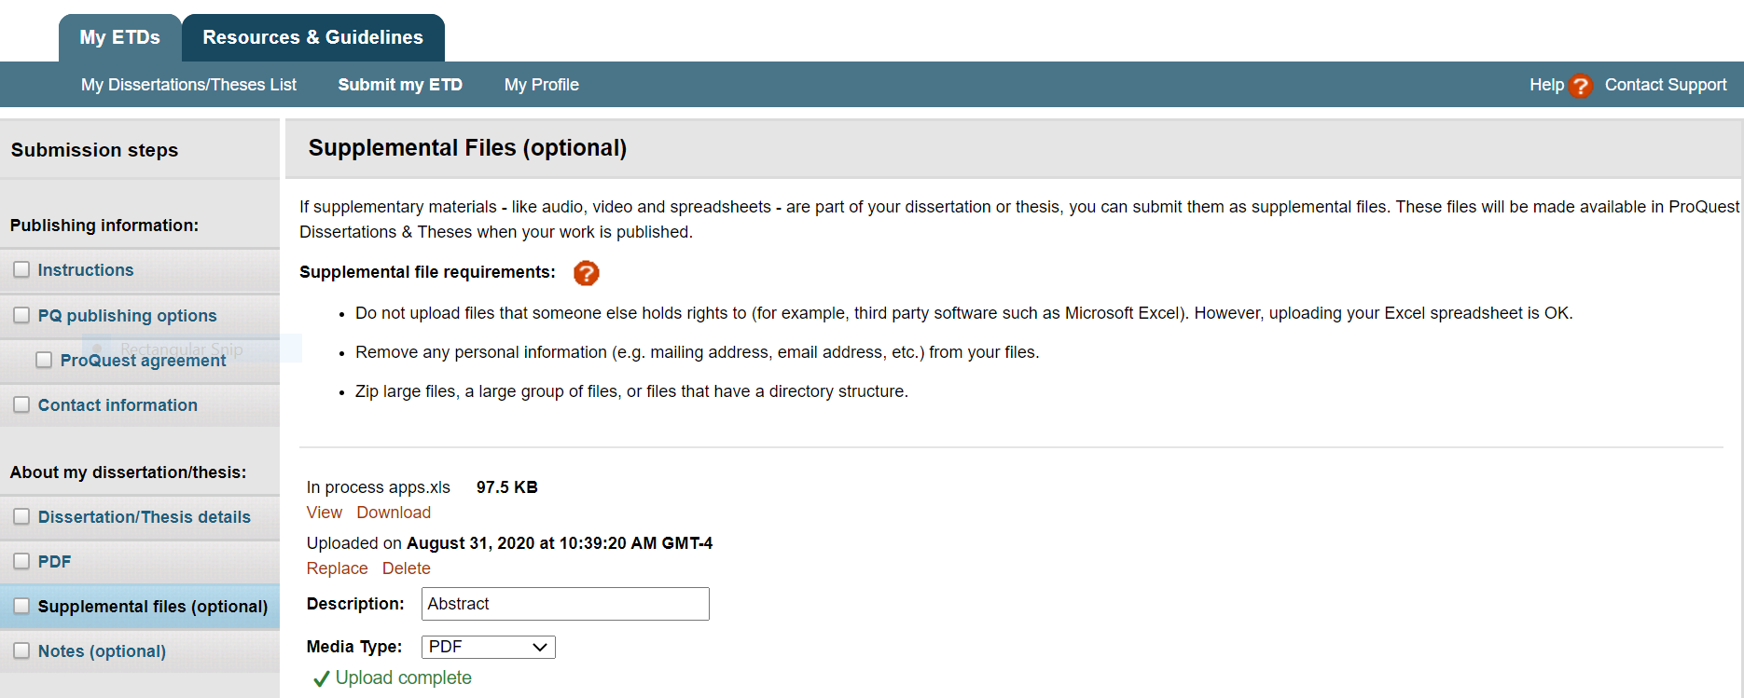
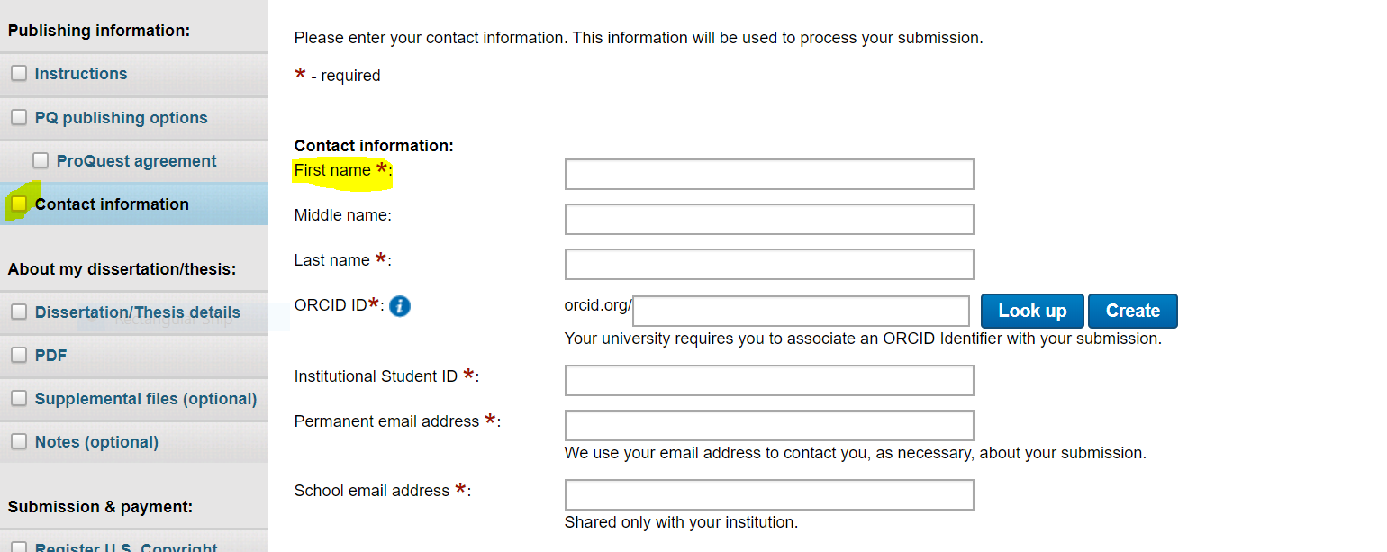
Proquest: How to navigate
Use the tabs on the left-hand side in grey to change sections—DQ Proposal process uses contact information, dissertation/thesis details, and supplemental files.
Contact Information

Slide 6
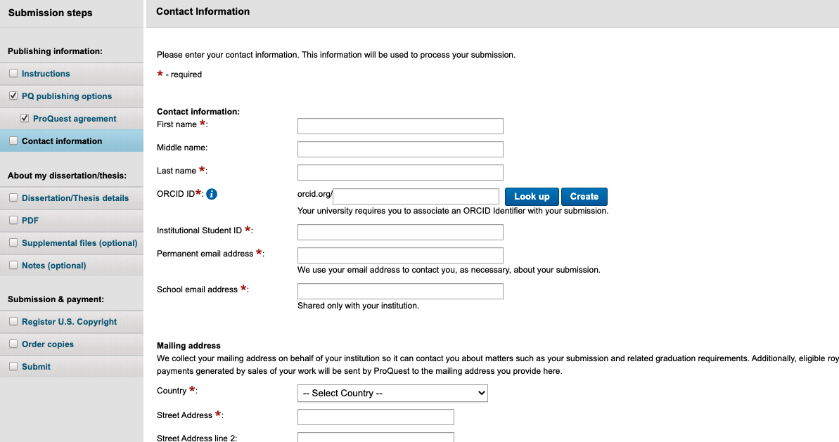
Proquest—contact information & OrCID Information
Please provide your catamount email address
You will need to create an ORCID identifier with your contact—follow the prompts

Slide 7
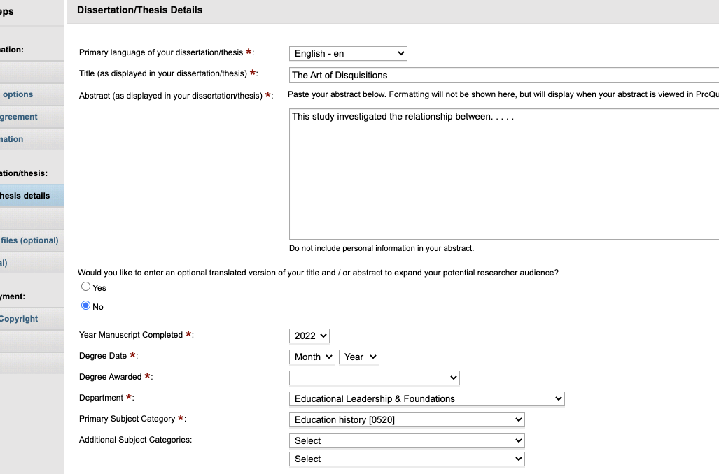
PROQUEST-Dissertation/Thesis details
Enter your title—can be tentative until Feb. 15 (May grads); Oct. 15 (Dec grads)
Enter your DQ Proposal Abstract
Enter your Committee Chair
Enter your Committee Members
Complete the remaining questions on the screen

Slide 8
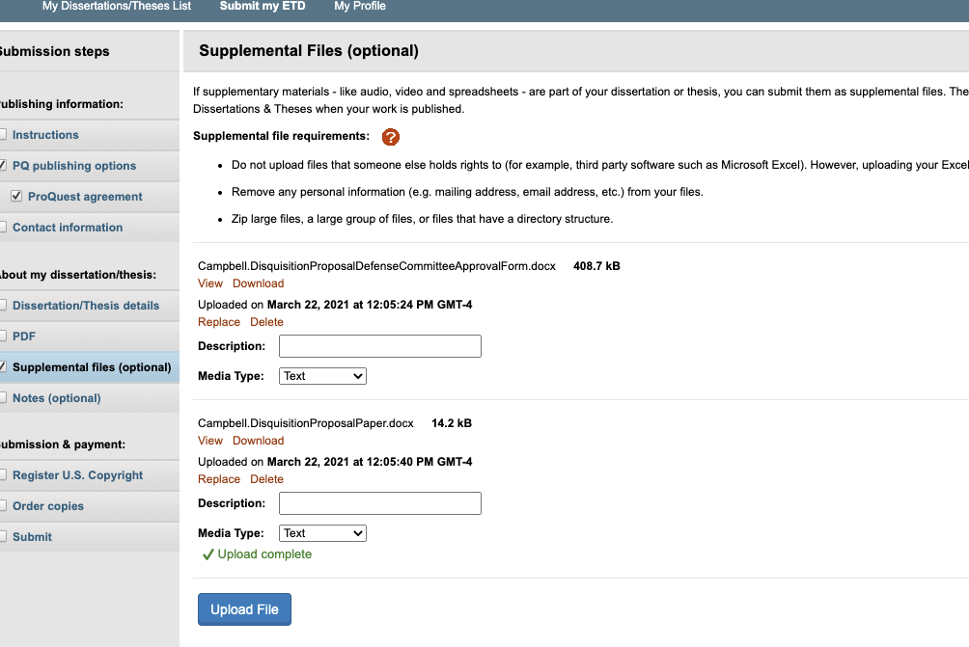
Proquest-Supplemental Files-2 documents required-May 15th Deadline
Disquisition Proposal Defense Committee Approval Form signed by committee members (linked on website)
*notice naming convention
Disquisition Proposal Paper (formatting APA, 7th ed)
*notice naming convention
* In addition, Please email your Defense Committee Approval Form to Denise Royer (droyer@wcu.edu)

Slide 9
DQ Proposal Process is complete
Do not hit submit—email The Graduate School (Grad@wcu.edu)
The Graduate School will verify committee and committee memberships
You will be added to the anticipated completion spreadsheet

Slide 10
The Final Disquisition (DQ)—assumes May graduation
The process and deadlines assume May graduation—work with your Program Director and Committee Chair for Dec or August completions
Fall 3/Spring 3 semester students defend their Final DQ to their committees
Following successful defense of Final DQ, students should submit their DQ defense documents to PROQUEST by April 10th (see required documents on next slide)
Students should also email Final Disquisition Committee Approval Forms (with signatures) and the final DQ document to Denise Royer (droyer@wcu.edu)

Slide 11
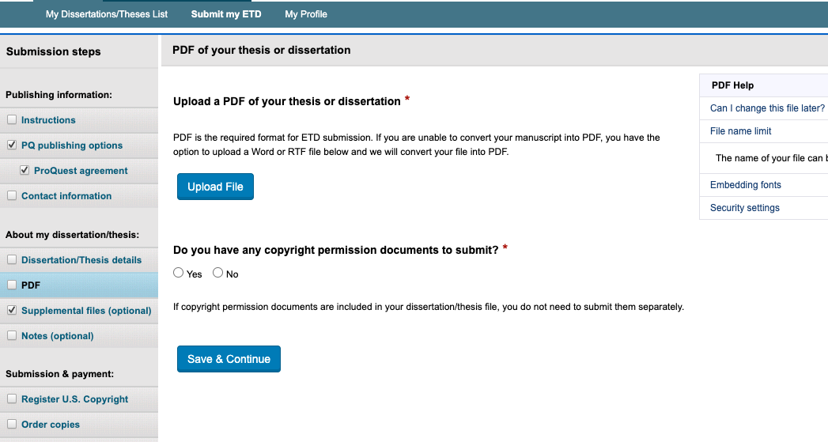
PROQUEST-FINAL DQ DEFENSE DOCUMENTS-Due Date April 10th
Final Disquisition Committee Form signed (supplemental forms)
Final DQ paper with all revisions requested by committee (pdf section)
After uploading final DQ and signed committee forms, hit
SUBMIT

Slide 12
Graduate School Role--Processing for Completion
Review DQ
Print Final approval form
Upload Dean’s signature form
Clear for graduation
Correct Graduate School formatting (review guide)
Might be returned for edits
Time is of the essence
Graduate School will print the signed Final Approval Form and will send it to Dean of Graduate School for approval/signature
Graduate School will upload the signed Final Approval Form with the Dean’s signature back to student’s ProQuest Account
Graduate School will mark the DQ as complete and ready for publication
Student will be notified via Proquest of successful completion

Slide 13
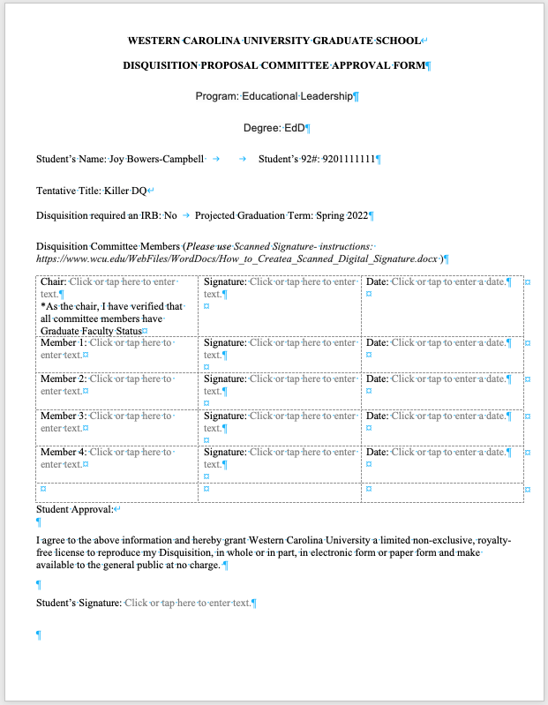
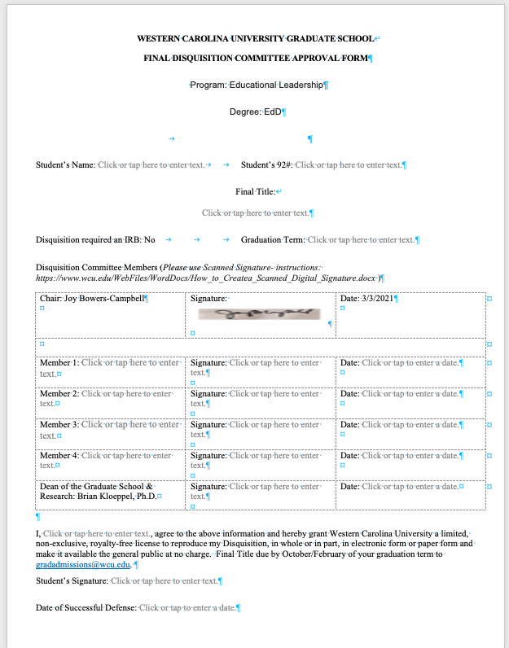
about the forms. . . . . . .
Forms are word docs--Available on website (4/15/21)
Face to Face defense-–wet signatures are fine—scan the completed form to your computer-upload
Electronic defenses—electronic signatures-faculty might need coaching

Slide 14
Formatting Issues
Avoid formatting Issues by reading the guide before you begin writing
Graduate school formatting guide differs from APA 7th edition in several ways:
Eliminate the running header
Page numbers are on the bottom of page centered
Roman Numerals are used for font matter; Title page is i but it is not used; begin with ii
Reach out to Graduate School Staff early with questions
Use tools in Word to assist with Table of Contents and Figures
Learn about these tools before you begin
Schedule sessions with writing center and tutors early

Slide 15
Resources & Guidelines—in ProQuest

Slide 16
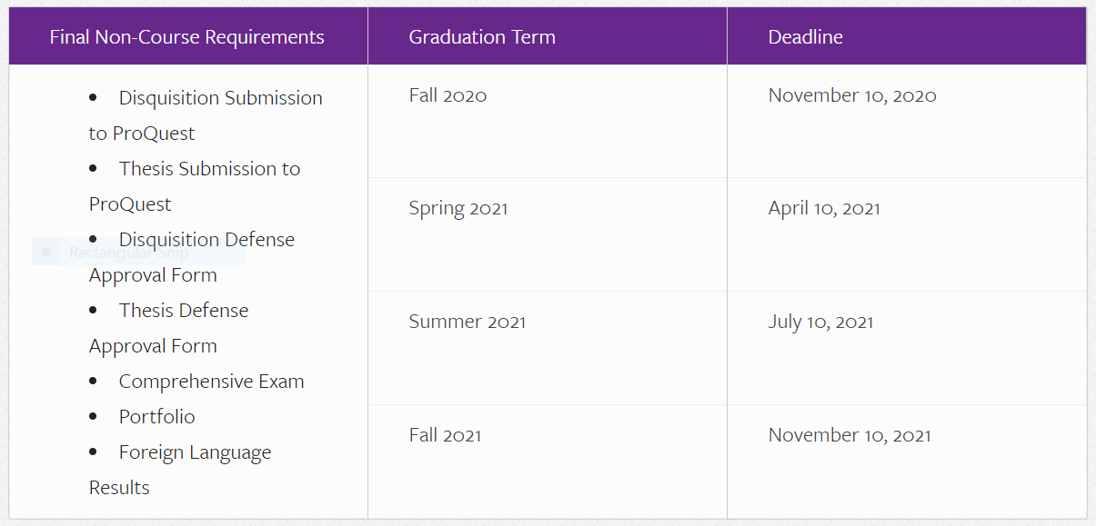
Disquisition Resources on Web
(under construction)
Thesis and Disquisition Information and Resources
https://www.wcu.edu/apply/graduate-school/students/Thesis-and-Disseration-Resources.aspx
*Will be updated by April 15 2021

Slide 17
GOOD Luck!

