Slide 1
Western Carolina University
Controller’s Office
Capital Assets

Slide 2
Governing Standards
Office of the State Controller
UNC Business Process Standards

Slide 3
Controller’s Office Responsibilities
To maintain and control the university’s inventory records
To update the asset records in the accounting system for information submitted on various forms
To assure each department verifies and certifies the annual departmental inventory
To perform quarterly audits

Slide 4
Fixed Asset Policy Fixed Asset Coordinator’s Procedures and Responsibilities
Information and forms available here:
WCU’s website
Click magnifying glass and type, “Controller’s Office”
Select first link listed as, “Controller’s Office”
Select, “Fixed Assets” on right side of page

Slide 5
Fixed Asset Policy
Fixed Asset Coordinator (FAC) Procedures and Responsibilities
Fixed Asset Coordinator PowerPoint Presentation
FORMS AND REPORTS List of FACs
WCU Asset Inventory Control
WCU Asset Inventory Control Form Whenever a qualifying asset is permanently moved, missing, or stolen, the department is required to complete this form (an asset qualifies if it is $5,000 or greater, or an IT tracked asset). If you have questions about whether an asset qualifies, please contact Dale Cox (227-2583) or Ed Lawson (227-7487).

Slide 6
Fixed Asset Policy
Applicability, Ownership, and Title
Custody and Control
Each department is responsible for maintaining inventory controls and safeguarding all assets regardless of cost. Department/Administrative Head is required to follow the university’s policies and procedures.
Equipment purchased through the university is property of the state and cannot be donated, traded-in (if used as partial payment on new equipment and/or not under warranty), sold, scrapped, or otherwise disposed of by the department who has custody of the equipment without prior approval from the Purchasing Department (Regina Cowan).

Slide 7
Fixed Asset Policy
Generally (rare exception), unless terms are more specific, when equipment is purchased from grants, ownership of asset belongs to the university, thus becoming state property; not individual or departmental property.
Contact Director of Grants (ext. 2498) or Fixed Asset Accountant (ext. 2583) with any questions concerning assets purchased from grant funding
Tracking of Equipment
Controller’s Office (IT/Non-IT =>5,000)
Information Technology (IT)
Fixed Asset Coordinator (FAC)

Slide 8
Fixed Asset Coordinator (FAC)
The FAC will serve as the liaison between the unit and the University’s Fixed Assets Accountant (Controller’s Office) for items recorded in the University’s Fixed Assets System and as the liaison to Information Technology for data processing items tracked by Information Technology. The FAC will become the unit’s resident fixed assets expert.
Pursuant to WCU Policy # 75, accountability for property purchased by (or for) a department, college, or other unit of the university is the responsibility of the department/administrative head of that unit.

Slide 9
FAC’s Responsibilities
Familiarity of tasks performed during the year
Updating asset’s location, condition, serial number, etc. (timely manner)
Missing asset (steps taken to locate)
Vandalized/Stolen asset
Campus Police
Fixed Asset Accountant (Controller’s Office)

Slide 10
Fixed Asset Policy
Fixed Asset Coordinator (FAC) Procedures and Responsibilities
Fixed Asset Coordinator PowerPoint Presentation
FORMS AND REPORTS List of FACs
WCU Asset Inventory Control
WCU Asset Inventory Control Form Whenever a qualifying asset is permanently moved, missing, or stolen, the department is required to complete this form (an asset qualifies if it is $5,000 or greater, or an IT tracked asset). If you have questions about whether an asset qualifies, please contact Dale Cox (227-2583) or Ed Lawson (227-7487).

Slide 11
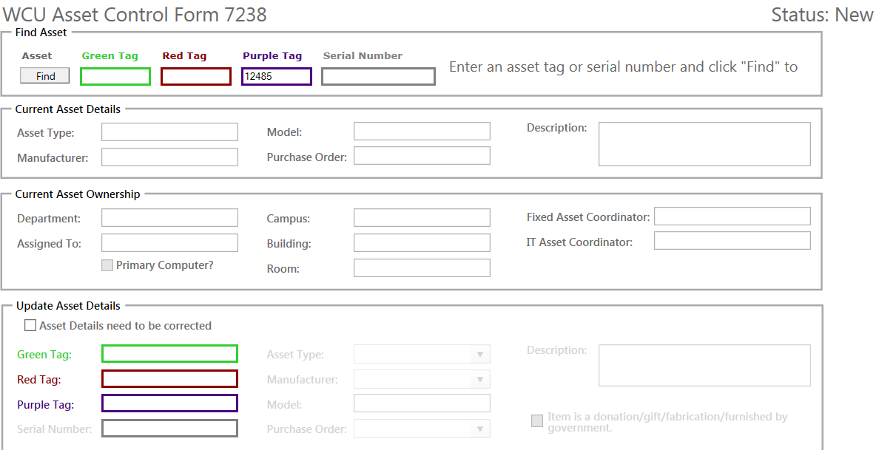

Slide 12
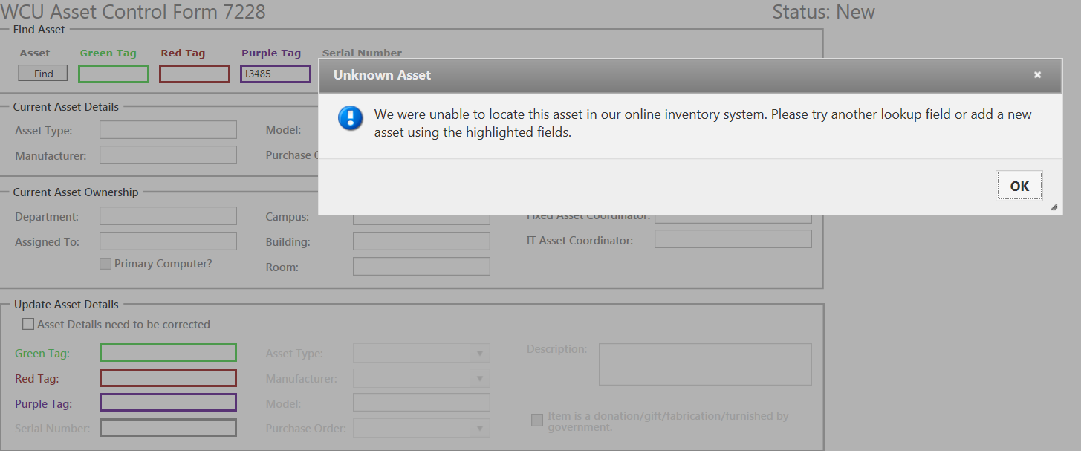

Slide 13
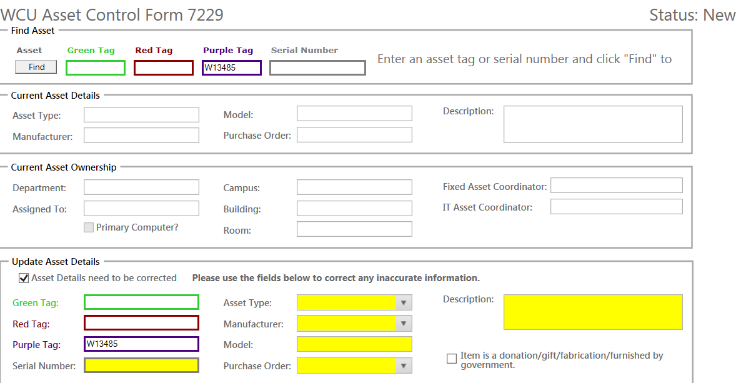

Slide 14
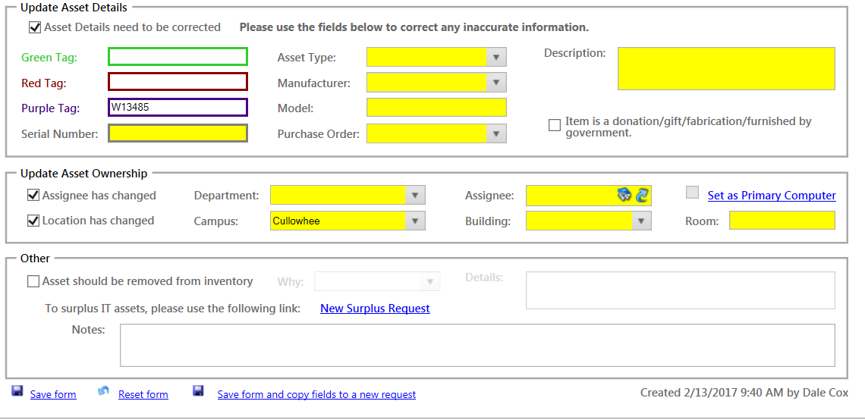

Slide 15
FAC’s Responsibilities
Familiarity of tasks performed during the year
Gift/Donation
Prior to acceptance & receipt, contact Office of Development
Fixed Asset Accountant (Controller’s Office)
Fabricated assets (by assembly)
For gift/donation or fabricated assets, go on-line to the WCU Asset Inventory Control Form. Go to, “Update Asset Details” and check the box beside, “Asset details need to be corrected.” Then, check the box beside “Item is a donation/gift/fabrication/furnished by government.” In the, “Description” field, give detail information.

Slide 16
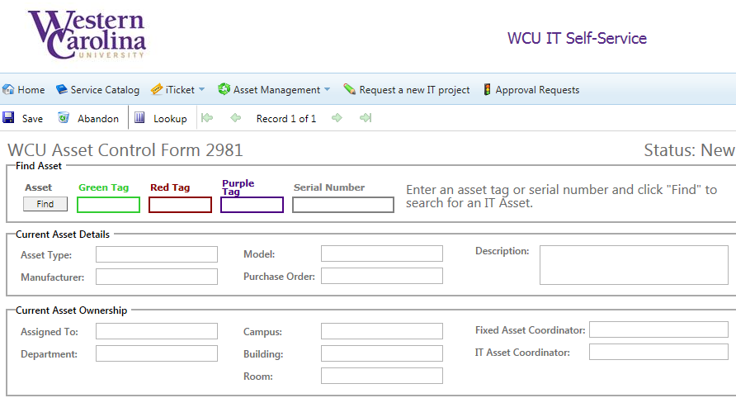

Slide 17
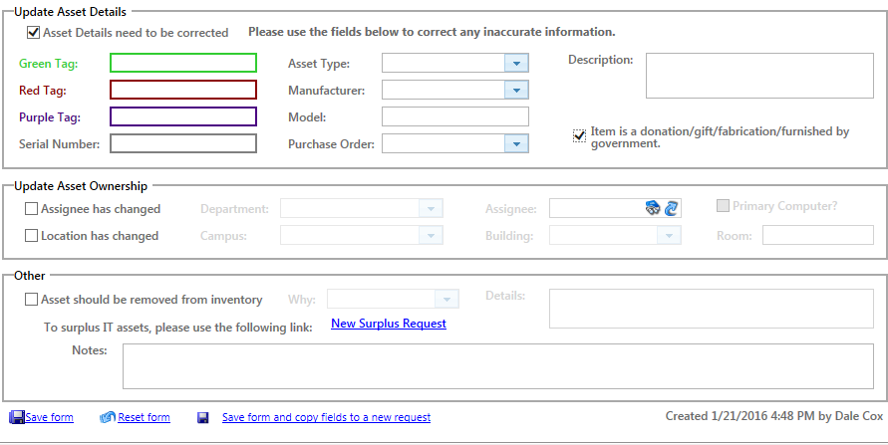

Slide 18
FAC’s Responsibilities
Familiarity of tasks performed during the year
Trade-Ins (used as partial payment on new equipment and/or not under warranty)
Notify Surplus Property Manager (Regina Cowan)
Surplus Property Manager contacts State Surplus Office
If approved, Surplus Property Manager contacts department; purple/red tag(s) removed - sent to Fixed Asset Accountant, Controller’s Office, HFR 300-O; green tag removed-sent to IT Asset Coordinator, Ed Lawson, Hunter Library H59
Asset returned to vendor (i.e. insufficient funds)
WCU tag(s) removed and sent to appropriate personnel

Slide 19
FAC’s Responsibilities
Familiarity of tasks performed during the year
▪ For trade-ins (used as partial payment on new equipment and/or not under warranty) and assets returned to vendor, complete the Equipment Return Form. Since the department/administrative head’s signature is required, print, receive signature, and send (or email) the form to Fixed Asset Accountant, Controller’s Office, HFR 300-O. Retain a copy in the department.

Slide 20
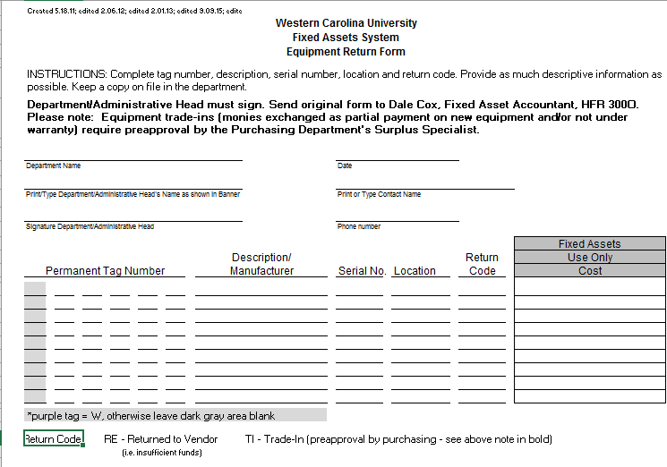

Slide 21
FAC’s Responsibilities
Familiarity of tasks performed during the year
Asset permanently transferred to another university or state agency
Notify Surplus Property Manager (Regina Cowan)
Surplus Property Manager contacts State Surplus Office
If approved, Surplus Property Manager contacts the FAC; purple/red tag(s) removed-sent to Fixed Asset Accountant, Controller’s Office, HFR 300-O; green tag removed-sent to IT Asset Coordinator, Ed Lawson, Hunter Library H59
Asset transferred to another department on campus

Slide 22
FAC’s Responsibilities
Familiarity of tasks performed during the year
▪ For assets transferred, complete the Equipment Transfer Form. The department/administrative head’s signature is required so print, receive signature, and send (or email) the form to Fixed Asset Accountant, Controller’s Office, HFR 300-O. Retain a copy in the department.
Note: Department transferring asset to another department on campus should complete the Equipment Transfer Form. Then, the receiving department should complete the WCU Asset Inventory Control Form so the correct organization and location is updated in the Banner Fixed Assets Module.

Slide 23
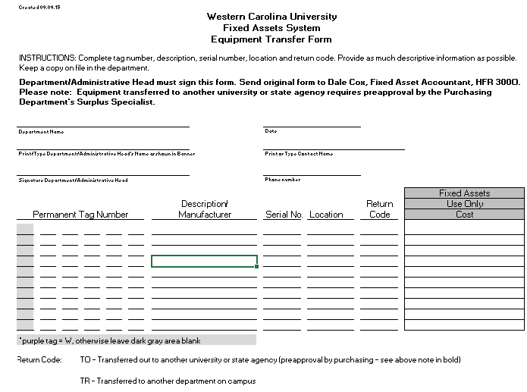

Slide 24
FIXED ASSET COORDINATOR
Please send an email to all in your college or department notifying them of the importance for completing the WCU Asset Inventory Control Form, the Equipment Return Form, and the Equipment Transfer Form. Refer them to the “Forms and Reports” page located on the website under Controller’s Office; Fixed Assets

Slide 25
FORMS AND REPORTS List of FACs
WCU Asset Inventory Control
Whenever a qualifying asset is permanently moved, missing, or stolen, the department is required to complete this form (an asset qualifies if it is $5,000 or greater, or an IT tracked asset). If you have questions about whether an asset qualifies, please call Dale Cox (227-2583) or Ed Lawson (227-7487).
WCU Equipment Return Form
Used to record equipment returned to vendor such as trade-ins (preapproved by Purchasing) or due to insufficient funds from departmental budget.
WCU Equipment Transfer Form
Used to record equipment permanently transferred to another university or state agency (preapproved by Purchasing) or transferred to another department on campus.

Slide 26
FAC’s Responsibilities
Familiarity of tasks performed during the year
Surplus
Disposals
Cannibalization

Slide 27
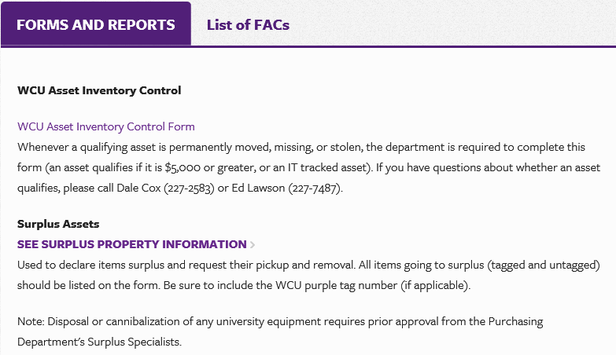

Slide 28
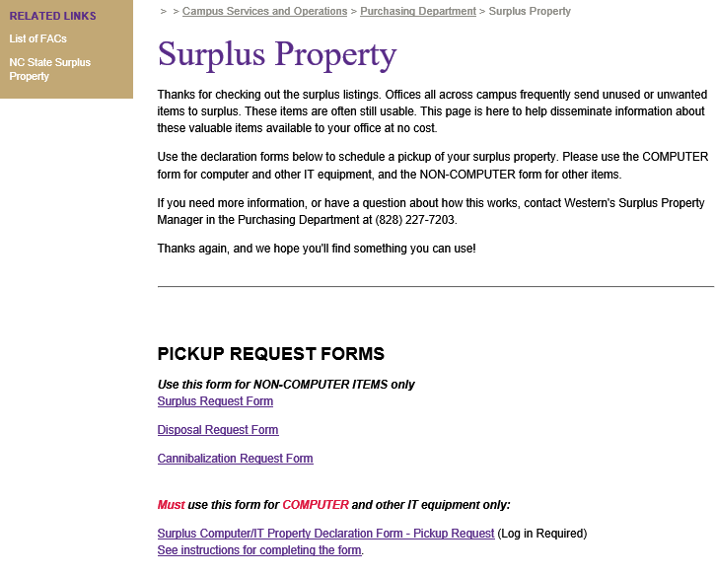

Slide 29
Form Number Assignment
Please follow the instructions below, starting with clicking the button. You will be assigned a number.
Your number is:
Copy and paste this number into the number box on the form below.
Fill out the requisition - hit enter to add more lines of text. (Note: If you need more than one page to enter your, use continuation form below)
Print. (Note: You may save the form, and just click for the next available number)
Surplus Request (Excel)
Disposal Request (Excel)
Cannibalization Request (Excel)

Slide 33
FAC’s Responsibilities
Familiarity of tasks performed during the year
Annual Departmental Fixed Asset Inventory
Visual verification of asset – place “Y” in Y/N column
Note any asset updates in “Comments” column (if updates are needed, complete correct fixed asset form)
List – IT tag (green) on spreadsheet if applicable
Remaining useful life 60 months or less (ignore zero)
Appropriate departmental individual evaluates and recommends extension of useful life (in months/years) and notes in “Comments” column
Completed inventory spreadsheet email to Dale Cox or send to Fixed Asset Accountant, Controller’s Office, HFR 300-O
Copy retained in department

Slide 34
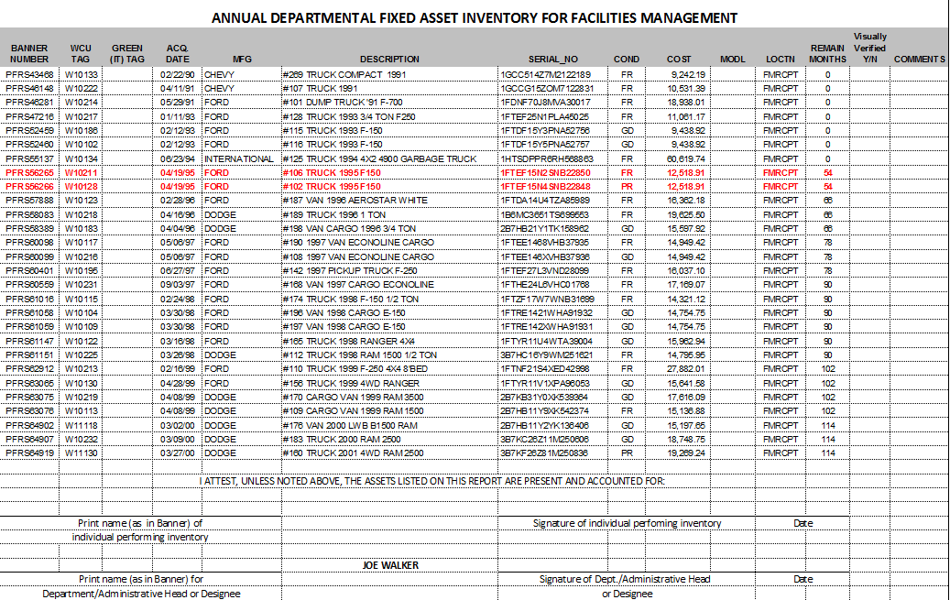

Slide 35
Capital Assets - Impairments
Impairment – An asset’s service utility has declined significantly and unexpectedly
Common Indicators
▪ Evidence of physical damage (e.g., fire or natural disaster)
▪ Changes in legal or environmental factors (e.g., asset does not
meet certain requirements)
▪ Technological change or obsolescence (e.g., asset outdated and
newer asset provides better service)
▪ Changes in manner or duration of use (e.g., asset no
longer used with remaining useful life due to safety reasons)
▶ GASB Statement 42

Slide 36
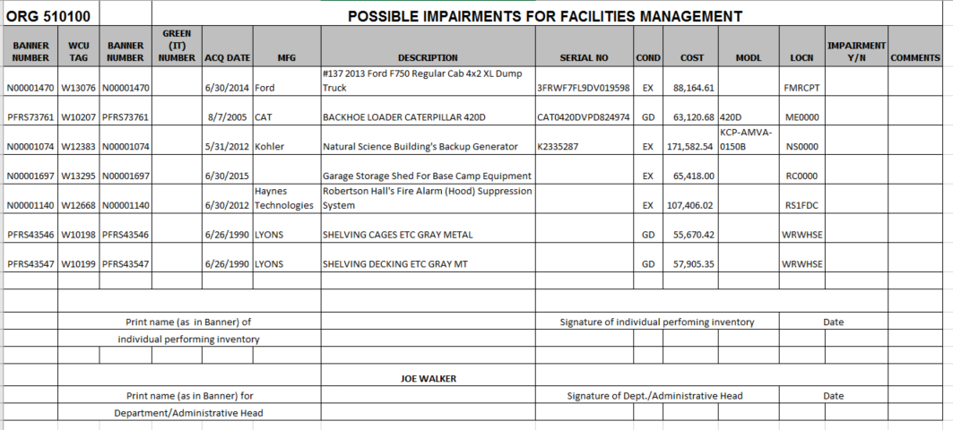

Slide 37
QUESTIONNAIRE FOR CAPITAL ASSET IMPAIRMENTS
1) Please list any impaired WCU capital asset at February 28, 2017. A capital asset is considered impaired when its service utility has declined significantly and unexpectedly.
Please refer to the information on GASB 42 provided in the email’s attachment and limit your listings to major, significant impairments.
2) Please provide a general description of the impairment.
3) For any listed impaired capital asset, is the impairment temporary or permanent?
4) For each listed impaired capital asset, what is the gross amount of the impairment loss?
5) For each listed impaired capital asset, what is the amount of any insurance recovery?

Slide 38
Internal Tracking
It is recommended that departments have internal tracking procedures for equipment not being tracked in the University’s Fixed Assets System or by IT.

Slide 39
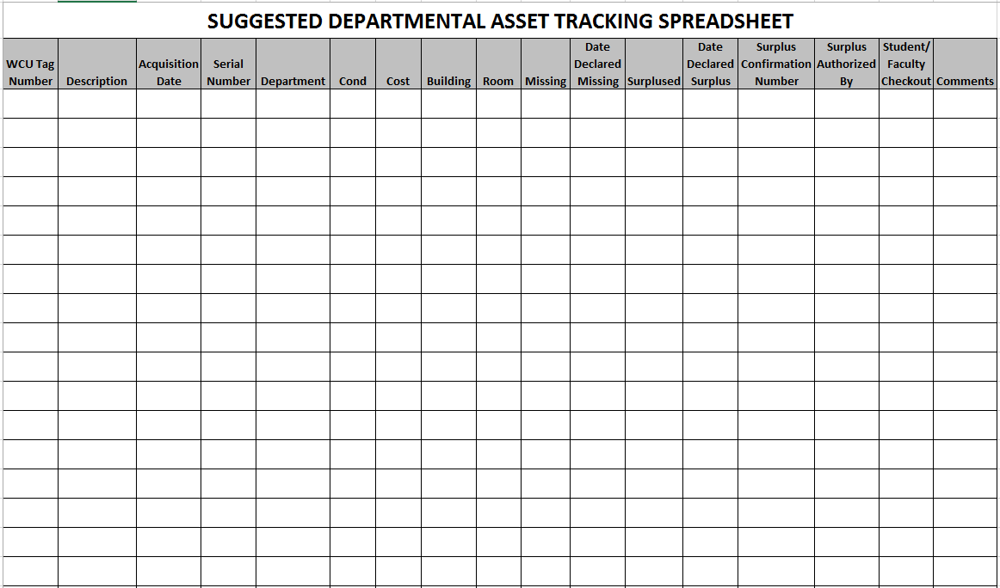

Slide 40
Significant Change of Event
Change in department head
Department or function moving from one building to another
Consideration should be made to perform interim physical inventories at the time of event
Management decision and based on risk factors and likelihood of assets becoming misplaced, not transferred, or stolen.

Slide 41
FORMS AND REPORTS List of FACs
WCU Asset Inventory Control
Whenever a qualifying asset is permanently moved, missing, or stolen, the department is required to complete this form (an asset qualifies if it is $5,000 or greater, or an IT tracked asset). If you have questions about whether an asset qualifies, please contact Dale Cox (227-2583) or Ed Lawson (227-7487).
Removing Assets from Campus Permission to Remove University Assets from Campus Form As a general rule, removal of university equipment, furnishings, and similar property from campus is not permitted. However, certain exceptions do exist and are listed on this form. For more information, see University Policy 75.

Slide 42
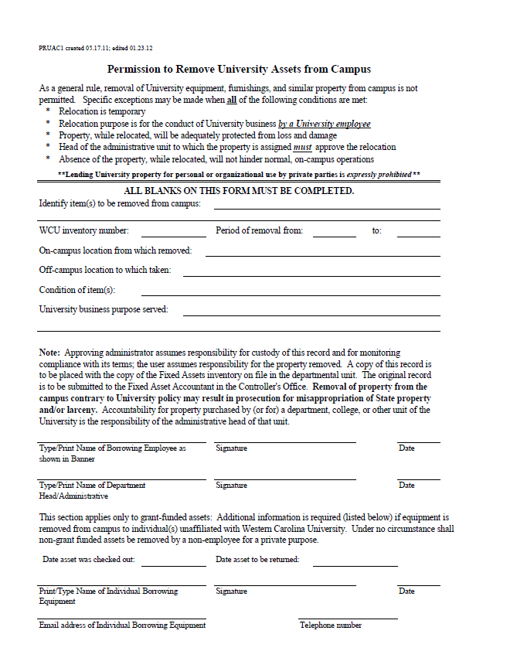

Slide 44
Western Carolina University
Division of Information Technology Asset Management

Slide 45
IT Assets
IT Assets
Non- IT Assets
Assets $5000
&
Above
Division of Information Technology (DoIT) charged with asset management for all IT assets that belong to WCU.

Slide 46
IT Assets
Computers a. Laptops & tablets b. Desktops
Monitors (only if greater than $500)
Printers for Paw Print only
Servers a. Enterprise level b. Snap
Enterprise level networking a. Switches b. Routers c. Wireless APs
Smart boards
Data projectors installed in classrooms
All technology assets purchased by DoIT

Slide 47
All IT items $5,000 and greater will be tracked by the Controller’s Office and DoIT
Tracking of assets valued $5,000 and greater will be the responsibility of the Controller’s Office. These items will be tagged with a purple color tag. It is understood some items $5,000 and greater may be an “IT” asset as well and will have both the purple tag and an IT asset tag which will be green. Older assets may still have the red WCU asset tag. Please do not remove any old tags.

Slide 48
Non-IT Assets
Tracking of assets valued under $5,000 and not listed as an IT asset will be the responsibility of the department/college. The department/college will be responsible for accounting for these assets directly to the WCU Controllers Office. DoIT will not be tracking these items unless purchased for the IT Department.

Slide 49
It is highly recommended that departments track assets of significant value to their unit and highly mobile such as listed below.
Scientific equipment (including computer if needed)
Portable hard drives
Port replicators
Monitors costing less than $500
Cameras of any kind
Keyboards / Mice
Portable CD drives
GPS systems
Smart devices - PDAs, phones, etc..
Label makers
Audio equipment
Specialized digital equipment - HVAC control systems, check writing machines, etc…
This list is not intended to be all inclusive

Slide 50
IT Asset Lifecycle
Acquire
Assets
Deploy
Assets
Manage Assets
Retire
Assets
Plan Assets

Slide 51
Acquiring IT Assets
Purchasing:
Department submits requisition to the Purchasing Department for purchase.
Purchasing places order for asset with “ship to” address specified by IT (currently warehouse). If you purchase directly from vendor make sure the asset is processed by IT.
Asset arrives at WCU.
Desktop Services picks up asset from warehouse for processing.

Slide 52
Deploy Assets
Desktop Services:
Assets are tagged and information is recorded into Cherwell.
If asset is a computer, it is prepped for WCU standards.
Asset is delivered to client and the Helpdesk is notified if additional setup is needed.

Slide 53
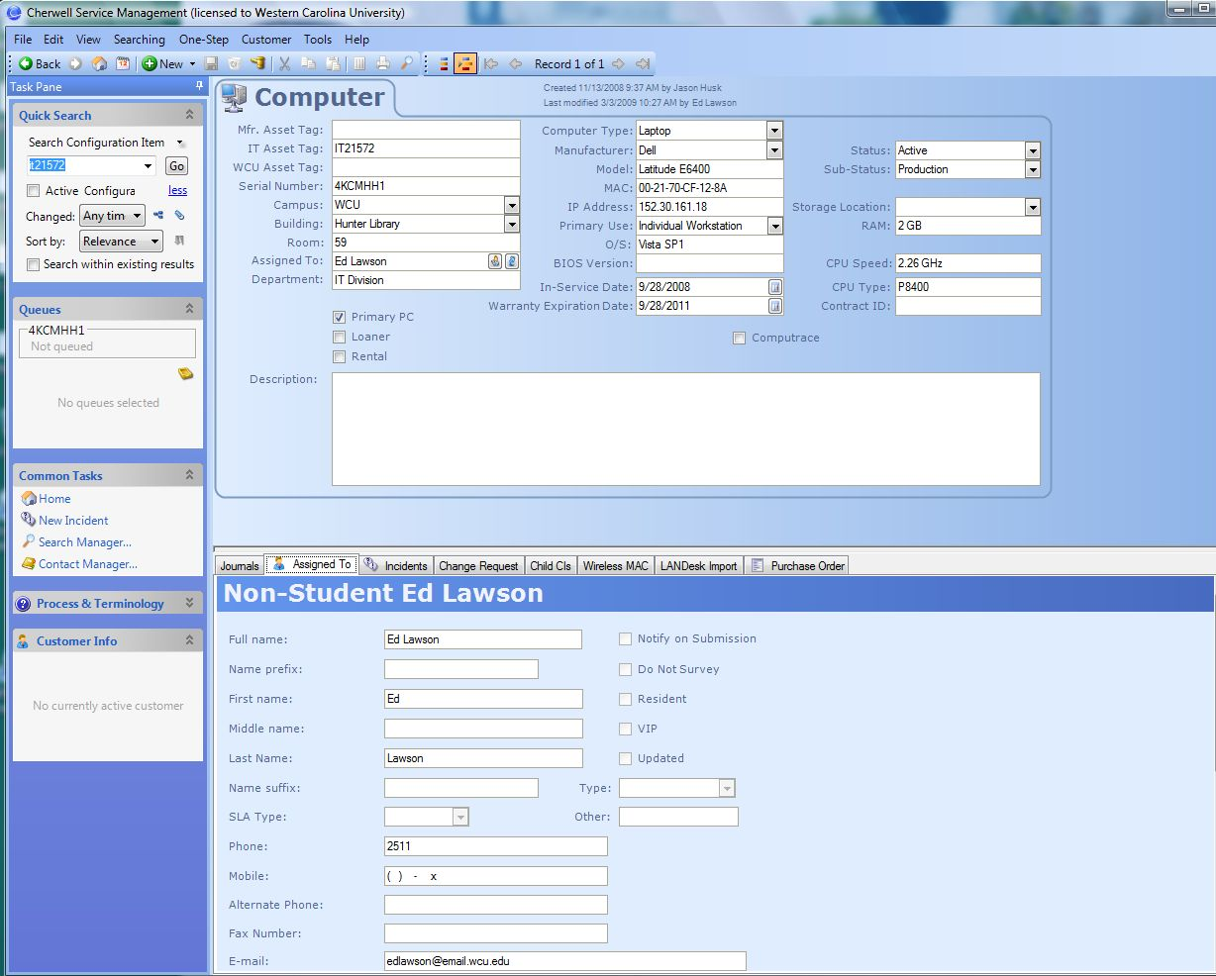

Slide 54
Manage Assets
The Division of Information Technology is using an inventory management system to track university owned technology assets. This system will allow IT to take a proactive stance towards computer replacement, integration of new technologies, and hardware upgrades for new software releases.
All IT assets that are being moved from one location to another must have an On-Line Asset Control Form completed for the move.
All old IT assets not in the new asset process are being manually tagged and entered into new system.
IT assets that are stolen or lost should be reported immediately to DoIT and proper authorities, and an ACF must be submitted.

Slide 55
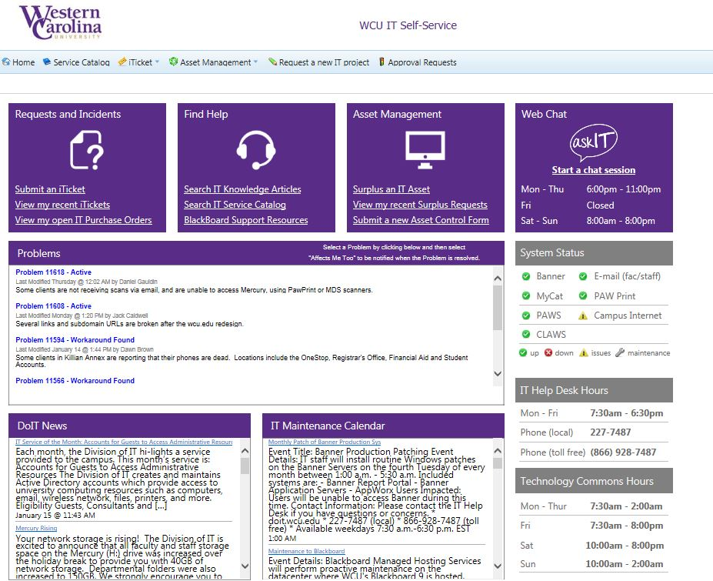

Slide 56
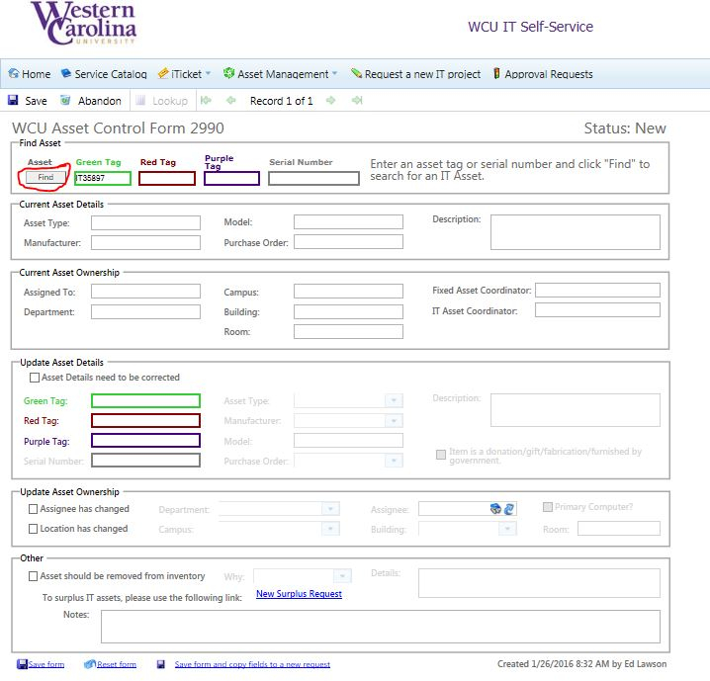

Slide 57
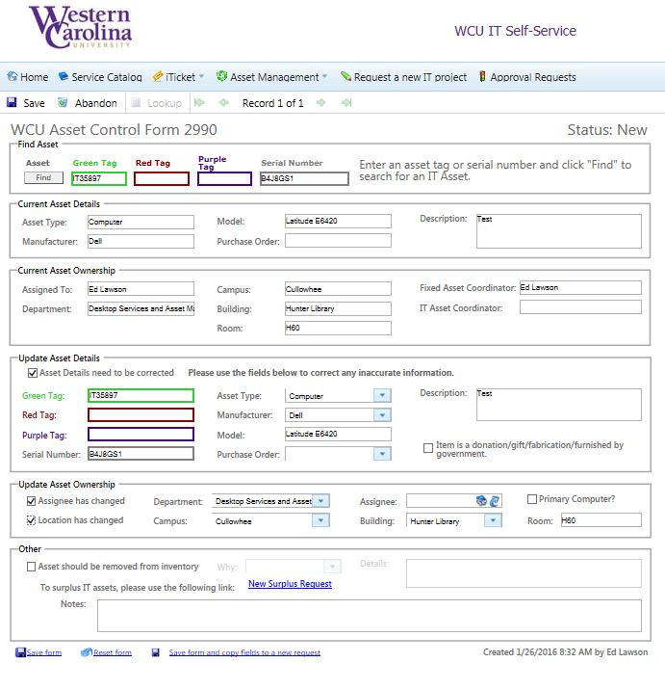

Slide 58
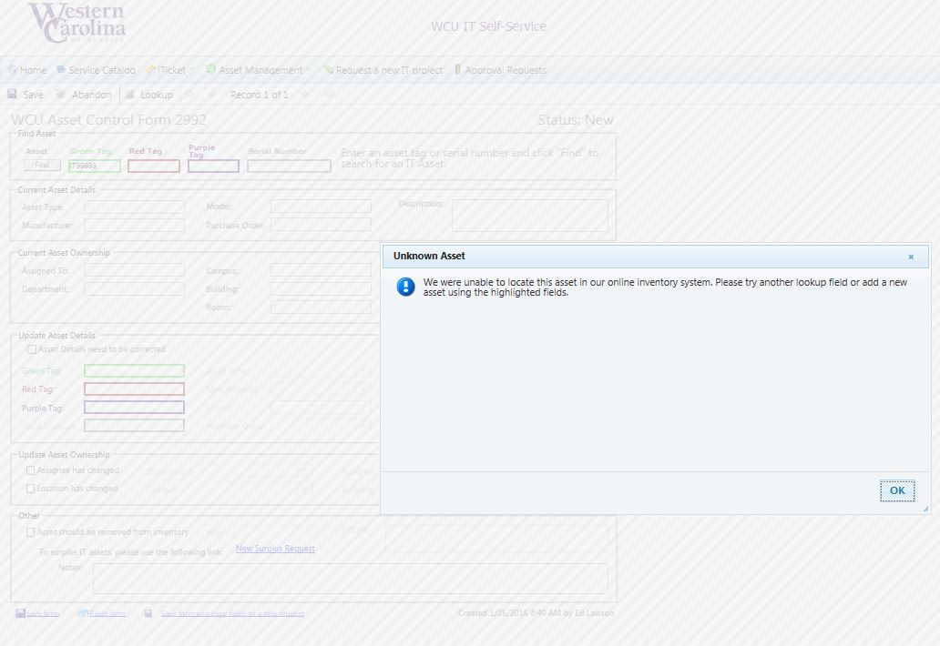

Slide 59
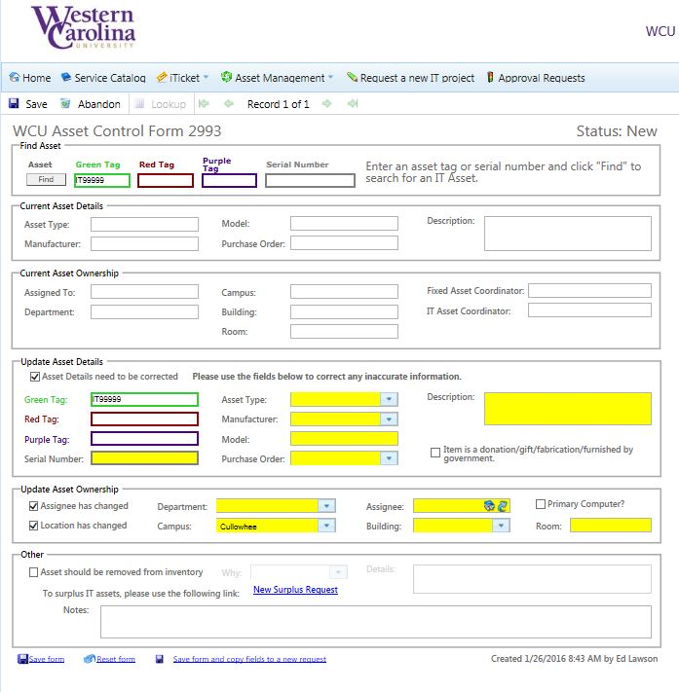

Slide 60
Retire Assets
Reallocation and Surplus:
Anytime a computer that is no longer being used by an individual or department and is still useable, the individual/department may chose to reallocate the computer within the area or propose it to be used by other individual/department. When this situation occurs, IT must be contacted and an ACF must be completed.
All assets to be surplused will be submitted through the IT Self-Service Portal on-line form.

Slide 61
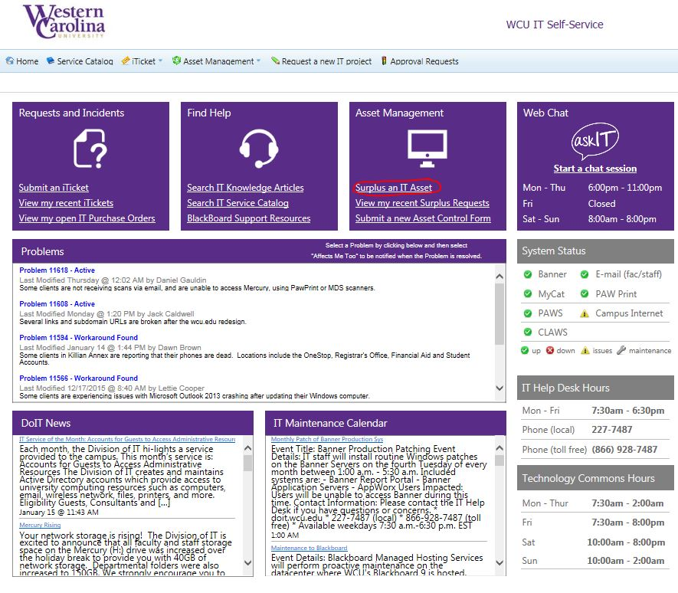

Slide 62
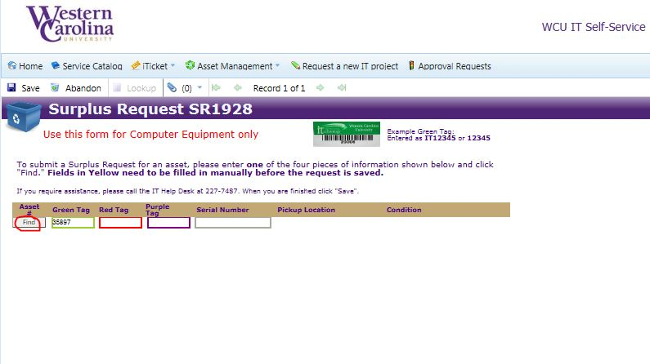

Slide 63
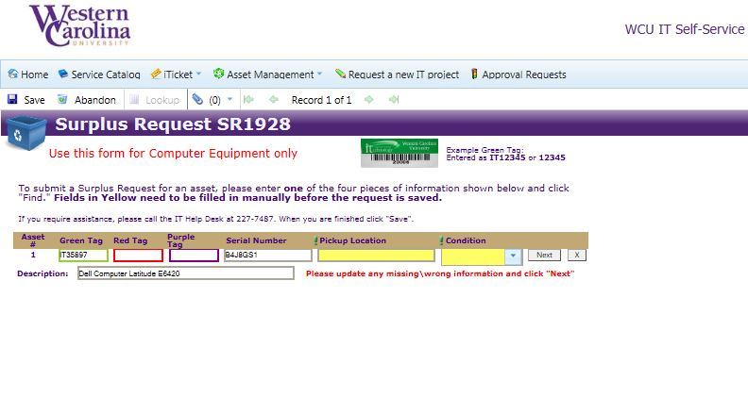

Slide 64
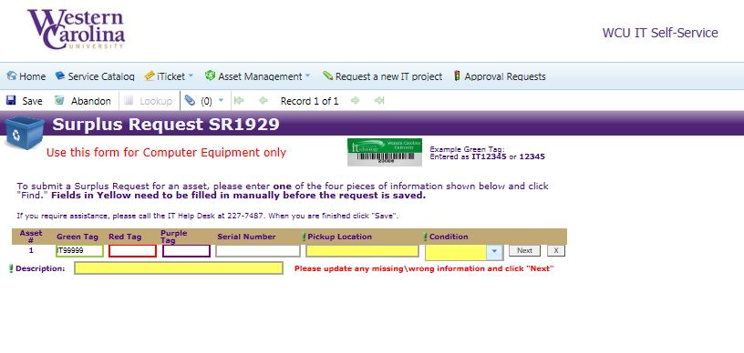

Slide 65
Plan Assets
IT asset data can be used in many ways
Align IT assets to WCU corporate and educational strategies.
Use IT asset data for short term and long term capital planning.
Use IT asset data to help campus develop IT productivity and customer satisfaction.

